Slide 1
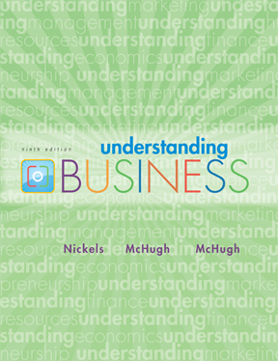
*
Chapter Six
*
Management and Leadership
McGraw-Hill/Irwin
Copyright © 2010 by The McGraw-Hill Companies, Inc. All rights reserved.
Notes:
‹#›

Slide 2

TODAY’S MANAGEMENT
*
Managers’ Roles Are Evolving
*
LG1
Management is the process used to accomplish organizational goals through planning, organizing, leading and controlling people and other organizational resources.
7-‹#›

Slide 3
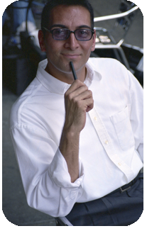
FOUR FUNCTIONS of MANAGEMENT
*
Four Functions
of Management
*
LG2
Planning
Organizing
Leading
Controlling
7-‹#›
Notes:
‹#›

Slide 4
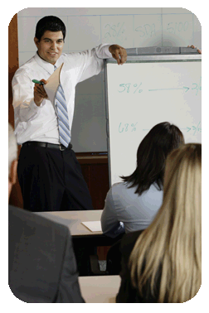
SHARING the VISION
*
Planning & Decision Making
*
Vision -- More than a goal, it’s a broad explanation of why the organization exists and where it’s trying to go. (future)
A mission statement outlines the organization’s fundamental purposes. (present)
Goals are the broad, long term accomplishments an organization wishes to attain.
Objectives are specific, short term statements detailing how to achieve the organization’s goals.
LG3
7-‹#›
Notes:
‹#›

Slide 5
BRAC
Our Vision
A world free from all forms of exploitation and discrimination where everyone has the opportunity to realise their potential.
Our Mission
Our mission is to empower people and communities in situations of poverty, illiteracy, disease and social injustice. Our interventions aim to achieve large scale, positive changes through economic and social programmes that enable men and women to realise their potential.
Our Values
Innovation
Integrity
Inclusiveness
Effectiveness

Slide 6
Amazon
"Our [Amazon's] vision is to be earth's most customer centric company; to build a place where people can come to find and discover anything they might want to buy online."

Slide 7
MISSION The mission of BRAC University is to foster the national development process through the creation of a centre of excellence in higher education that is responsive to society's needs, and able to develop creative leaders and actively contributes to learning and creation of knowledge. - See more at: http://www.bracu.ac.bd/about#sthash.z6eMkYZA.dpuf

Slide 8
Growing sales revenue in North America can be considered a goal. Expanding your distribution network is an objective used to reach the goal of raising company revenue.
Examples of Goals and Objectives Goals ‘“ I want to be a better cricket player. I want to learn more about Chinese history. I want to maximize my professional performance.
Objectives ‘“ I want to memorize the periodic table before my next quiz. I want to increase my sales by 10% this month. I want learn to play ‘Freebird’ on the guitar.

Slide 9
PLANNING ANSWERS FUNDAMENTAL QUESTIONS
*
Planning & Decision Making
*
LG3
What is the situation now?
SWOT Analysis -- Analyzes the organization’s Strengths, Weaknesses, Opportunities and Threats.
How can we get to our goal from here?
Strategic planning
Tactical planning
Operational planning
Contingency planning
7-‹#›

Slide 10
Potential Strengths Market leadership Strong research and development High-quality products Cost advantages Patents | Potential Weaknesses Large inventories Excess capacity for markets Management turnover Weak market image Lack of management depth
Potential Opportunities New overseas markets Falling trade barriers Competitors failing Diversification Economy rebounding | Potential Threats Market saturation Threat of takeover Low-cost foreign competition Slower market growth Growing government regulation

Slide 11

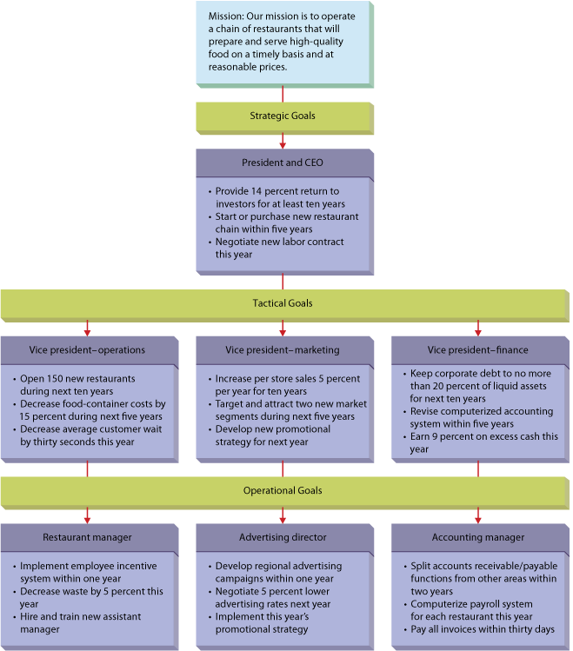
7.2
Kinds of Organizational Goals for a Regional Fast-Food Chain
7–‹#›
Notes:
© 2013 Cengage Learning. All rights reserved. May not be copied, scanned, or duplicated, in whole or in part, except for use as permitted in a license distributed with a certain product or service or otherwise on a password-protected website for classroom use.
7–‹#›
Management 11e Griffin

Slide 12
STRATEGIC and TACTICAL PLANNING
*
Planning & Decision Making
*
LG3
Strategic Planning -- Done by top management and determines the major goals of the organization and the policies, procedures, strategies and resources it will need to achieve them.
Tactical Planning -- The process of developing detailed, short-term statements about what is to be done, who is to do it and how.
7-‹#›

Slide 13
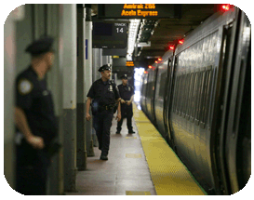
OPERATIONAL and CONTINGENCY PLANNING
*
Planning & Decision Making
*
LG3
Operational Planning -- The process of setting work standards and schedules necessary to implement the company’s tactical objectives.
Contingency Planning -- The process of preparing alternative courses of action the firm can use if its primary plans don’t work out.
7-‹#›

Slide 14
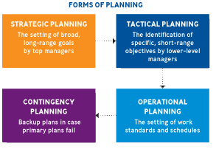
PLANNING FUNCTIONS
*
Planning & Decision Making
*
LG3
7-‹#›

Slide 15
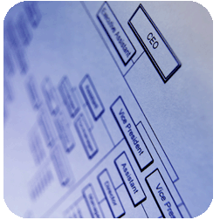
ORGANIZATIONAL CHARTS
*
Organizing: Creating a Unified System
*
LG4
Organization Chart -- A visual device that shows relationships among people and divides the organization’s work; it shows who reports to whom.
7-‹#›

Slide 16
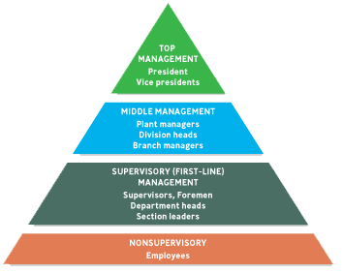
LEVELS of MANAGEMENT
*
Organizing: Creating a Unified System
*
LG4
7-‹#›

Slide 18

Formulating Business-Level Strategies
A number of frameworks have been developed for identifying the major strategic alternatives that organizations should consider when choosing their business-level strategies. Three important classification schemes are Porter’s generic strategies, the Miles and Snow typology, and strategies based on the product life cycle.

Slide 19
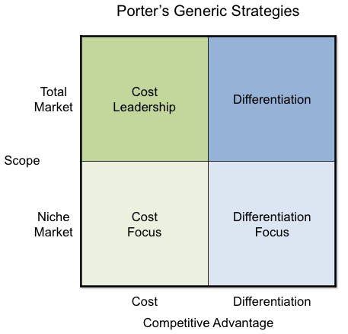
Porter’s Generic Strategies

Slide 20
Differentiation strategy
An organization that pursues a differentiation strategy seeks to distinguish itself from competitors through the quality (broadly defined) of its products or services. Firms that successfully implement a differentiation strategy are able to charge more than competitors because customers are willing to pay more to obtain the extra value they perceive.
UniMart follows a differentiation strategy to stand out in the competitive retail market by offering unique products, superior quality, and exceptional customer service. This approach attracts discerning customers willing to pay premium prices, fostering brand loyalty and reducing price sensitivity. While focusing on differentiation, UniMart also targets a broad market by balancing exclusivity with accessibility—offering a range of products at varying price points to appeal to diverse customer segments, from budget-conscious shoppers to premium buyers. This ensures wider reach while maintaining its differentiated appeal.

Slide 21
Overall Cost Leadership Strategy
Attempts to gain a competitive advantage by reducing its costs below the costs of competing firms. By keeping costs low, the organization is able to sell its products at low prices and still make a profit.
Timex uses an overall cost leadership strategy. For decades,. The price of Timex watches, starting around $39.95, is low because of the company’s efficient high volume manufacturing capacity

Slide 22
A Focus Strategy
concentrates on a specific regional market, product line, or group of buyers. This strategy may have either a differentiation focus, whereby the firm differentiates its products in the focus market, or an overall cost leadership focus, whereby the firm manufactures and sells its products at low cost in the focus market.
In the watch industry, Tag Heuer follows a focus differentiation strategy by selling only rugged waterproof watches to active consumers.
Fiat follows a focus cost focus strategy by selling its automobiles only in Italy and in selected regions of Europe;
Alfa Romeo uses focus differentiation to sell its high-performance cars in these same markets.
Hasselblad makes expensive cameras targeted at professional photographers.
Fisher-Price uses focus differentiation to sell electronic calculators with large, brightly colored buttons to the parents of preschoolers;
stockbroker Edward Jones focuses on small-town settings.
General Mills focuses one part of its new-product development on consumers who eat meals while driving—their watchword is “Can we make it ‘one-handed’?” so that drivers can safely eat or drink it.

Slide 23
Organizing
After managers have planned a course of action, they must organize the firm to accomplish their goals. That means allocating resources, (such as funds for various departments), assigning tasks, establishing procedures.

Slide 24
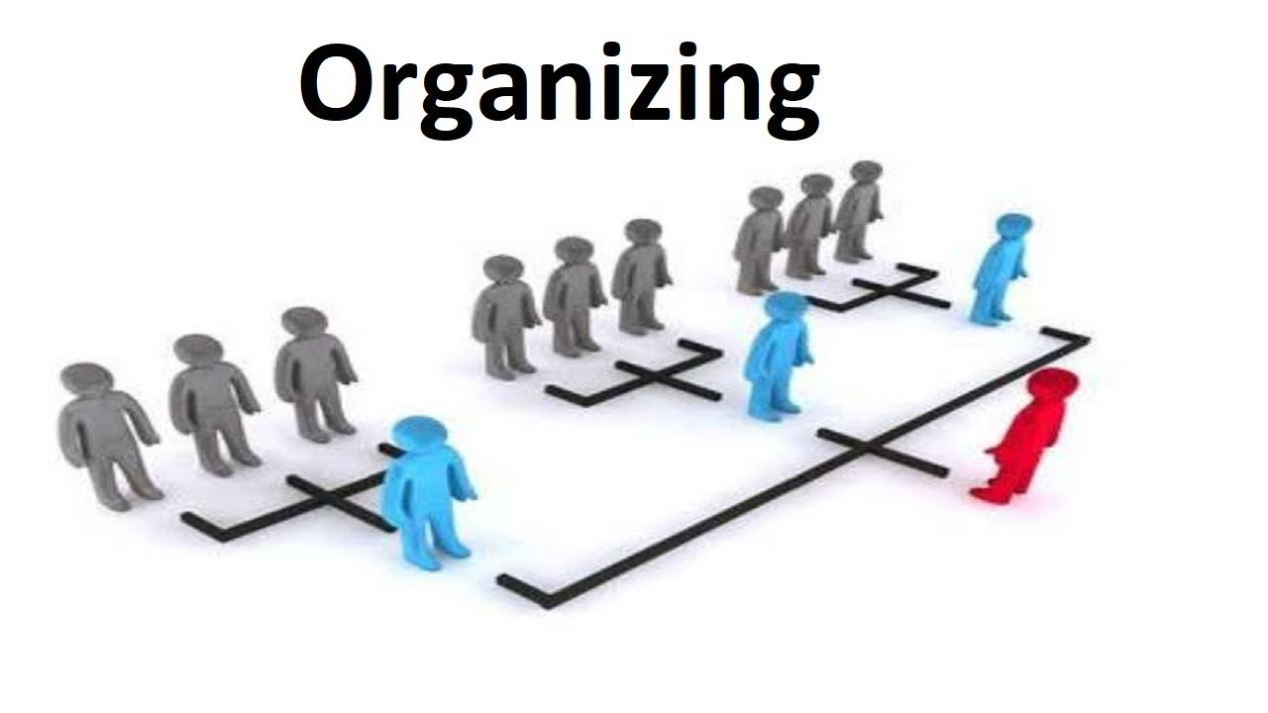
The Elements of Organizing
Imagine asking a child to build a castle with a set of building blocks. She selects a few small blocks and other larger ones. She uses some square ones, some round ones, and some triangular ones. When she finishes, she has her own castle, unlike any other. Another child, presented with the same task, constructs a different castle. He selects different blocks, for example, and combines them in different ways. The children’s activities—choosing certain combinations of blocks and then putting them together in unique ways—are in many ways analogous to the manager’s job of organizing.
Organizing is deciding how best to group organizational elements. Just as children select different kinds of building blocks, managers can choose a variety of structural possibilities. And just as the children can assemble the blocks in any number of ways, so, too, can managers put the organization together in many different ways. Understanding the nature of these building blocks and the different ways in which they can be configured can have a powerful impact on a firm’s competitiveness.

Slide 25

Organizing
Skills/Tasks
Technical- task in specific discipline
Human relation- involve communication and motivation
Conceptual- the ability to picture the org. as a whole
Staffing
Involves recruiting, hiring, motivating and retaining the best people available to accomplish the company’s objectives.
7-‹#›
Notes:
‹#›

Slide 26
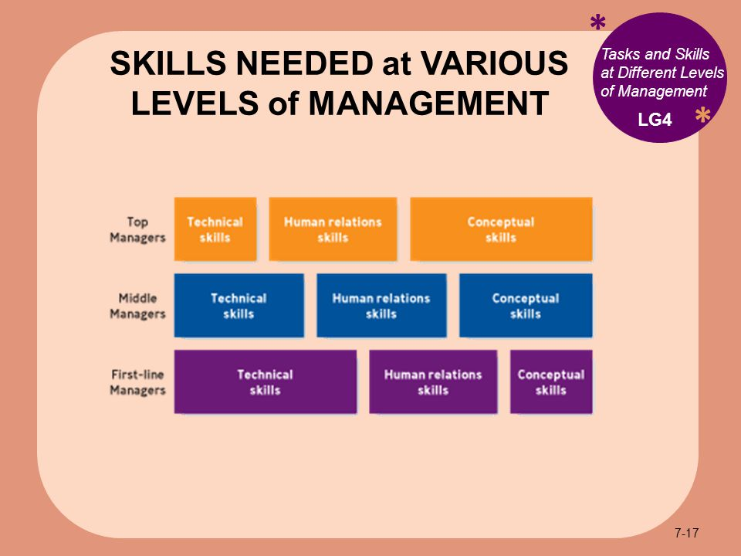

Slide 27
LEADERSHIP
*
Leading: Providing Continuous Vision and Values.
*
LG5
Leaders must:
Communicate a vision and rally others around that vision.
Establish corporate values.
Promote corporate ethics.
Embrace change.
Stress accountability and responsibility
7-‹#›
Notes:
‹#›

Slide 28
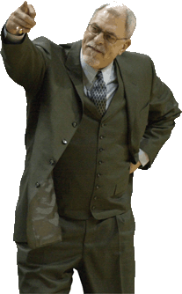
LEADERSHIP STYLES
*
Leadership Styles
Autocratic Leadership -- Making managerial decisions without consulting others.
Participative or Democratic Leadership -- Managers and employees work together to make decisions. flexibility, good listening skill, empathy
Free-Rein Leadership -- Managers set objectives and employees are free to do whatever is appropriate to accomplish those objectives. Warmth, friendliness & understanding
*
LG5
7-‹#›
Notes:
‹#›
mm

Slide 29
Controlling
The Control function measures performance relative to the planned objectives and standards, rewards people for work well done, and takes corrective action when necessary. Thus the control process (see Figure 7.8) provides the feedback that lets managers and workers adjust to deviations from plans and to changes in the environment that have affected performance. Controlling consist of five steps:

Slide 30
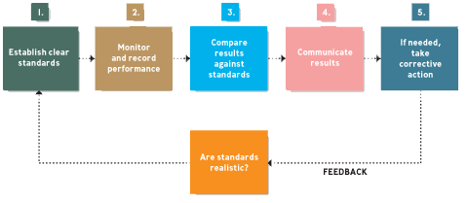
FIVE STEPS of CONTROLLING
*
Controlling: Making Sure it Works
*
LG6
7-‹#›
Notes:
‹#›

